Slide 1
Series and parallel connection - Resistor

Slide 2
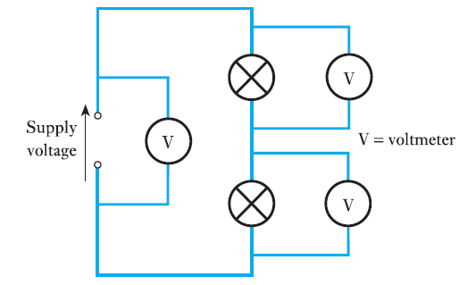
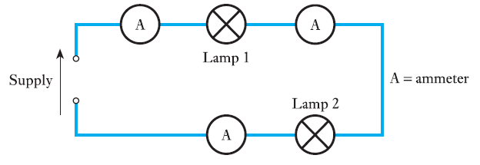
Series connection
A single path for the current to flow which is equal
Voltage across the components will be different
Lecture 6A

Slide 3
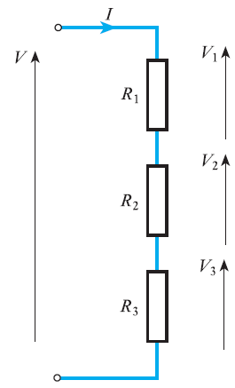
V = V₁ + V₂ + V₃
V = IR1 + IR2 + IR3
V = IR
IR = IR1 + IR2 + IR3
R = R1 + R2 + R3
Lecture 6A

Slide 4
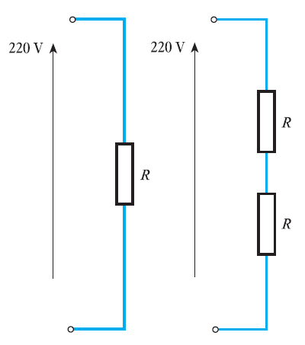
Calculate for each of the circuits shown below the current flowing in the circuit given that R = 3 kΩ.
I = V/R =220 / (3 * 10^3)
73mA
I = V/R =220 / (2*3 * 10^3)
36.5mA
Lecture 6A

Slide 5
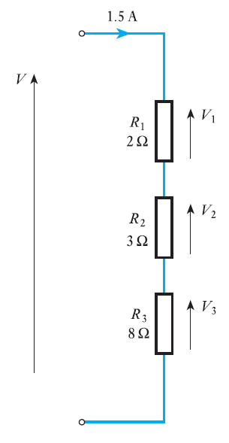
Calculate the voltage across each of the resistors shown below and hence calculate the supply voltage V.
V1 = IR1 = 1.5 × 2 = 3.0 V
V2 = IR2 = 1.5 × 3 = 4.5 V
V3 = IR3 = 1.5 × 8 = 12.0 V
V = V1 + V2 + V3 = 3.0 + 4.5 + 12.0 = 19.5 V
Lecture 6A

Slide 6
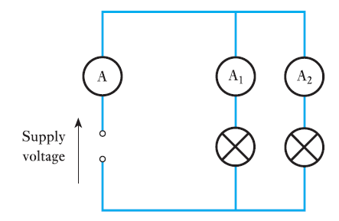
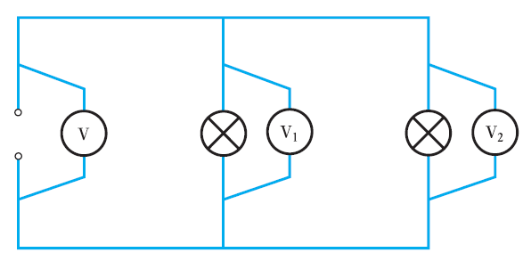
Parallel connection
Multiple path for the current to flow which is different
Voltage across the components will be equal
Lecture 6A

Slide 7
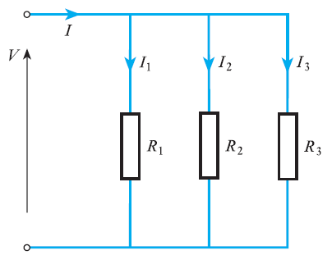
I = I1 + I2 + I3
I = V/R
Lecture 6A

Slide 8
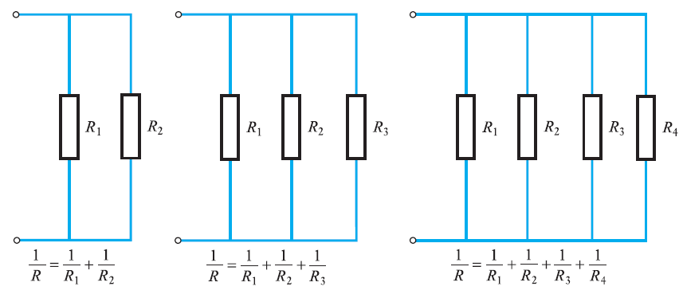
Lecture 6A

Slide 9
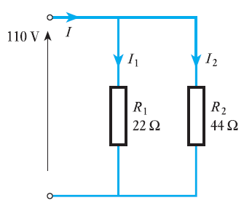
Calculate the supply current to the network shown
Lecture 6A

Slide 10
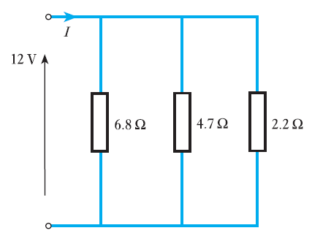
For the network shown, calculate the effective resistance and hence the supply current.
Lecture 6A

Slide 11
Reference
Edward Hughes. “Electrical and Electronic Technology”, 10th Edition, Pearson Education Asia, 2019
Lecture 6A

Slide 12
Thank You
Lecture 6A

